Slide 1



18 April 2025
IIT(ISM), DHANBAD
Dept. of Applied Geophysics
ML Based Facies Prediction from Wireline Logs
Group 02 members:
ASWINI S (24MT0094)
GLORY KIKON (23MC0040)
MANJUNATH (21JE0540)
NAVANEETH BABU M (22MC0058)
PRADYUT LAHA (23MC0056)
Course Coordinator:
Prof. Partha Pratim Mandal
GPD509 / NGPD502
1

Slide 2

Contents
Study Area and datasets
Quality check
PE log prediction
Facies Classification
Conclusions
Reference
2

Slide 3
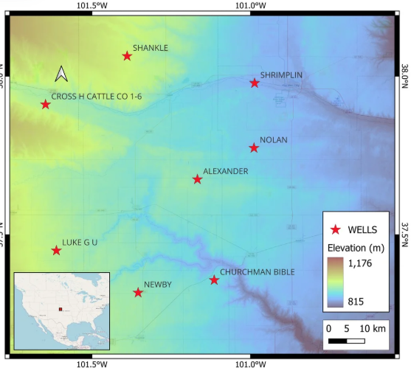
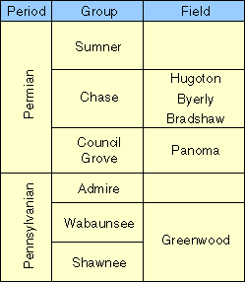
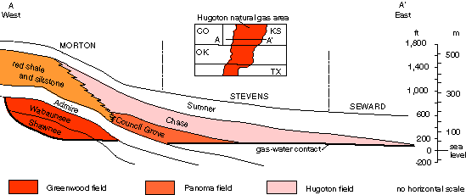
Study Area and datasets
Hugoton and Panoma fields are situated in the Hugoton Embayment, the shallow shelf portion of Anadarko basin.
Geologic units that produce gas in the Hugoton area.
3
Fig: Schematic west-east cross section, modified from Parham and Campbell, 1993.

Slide 4
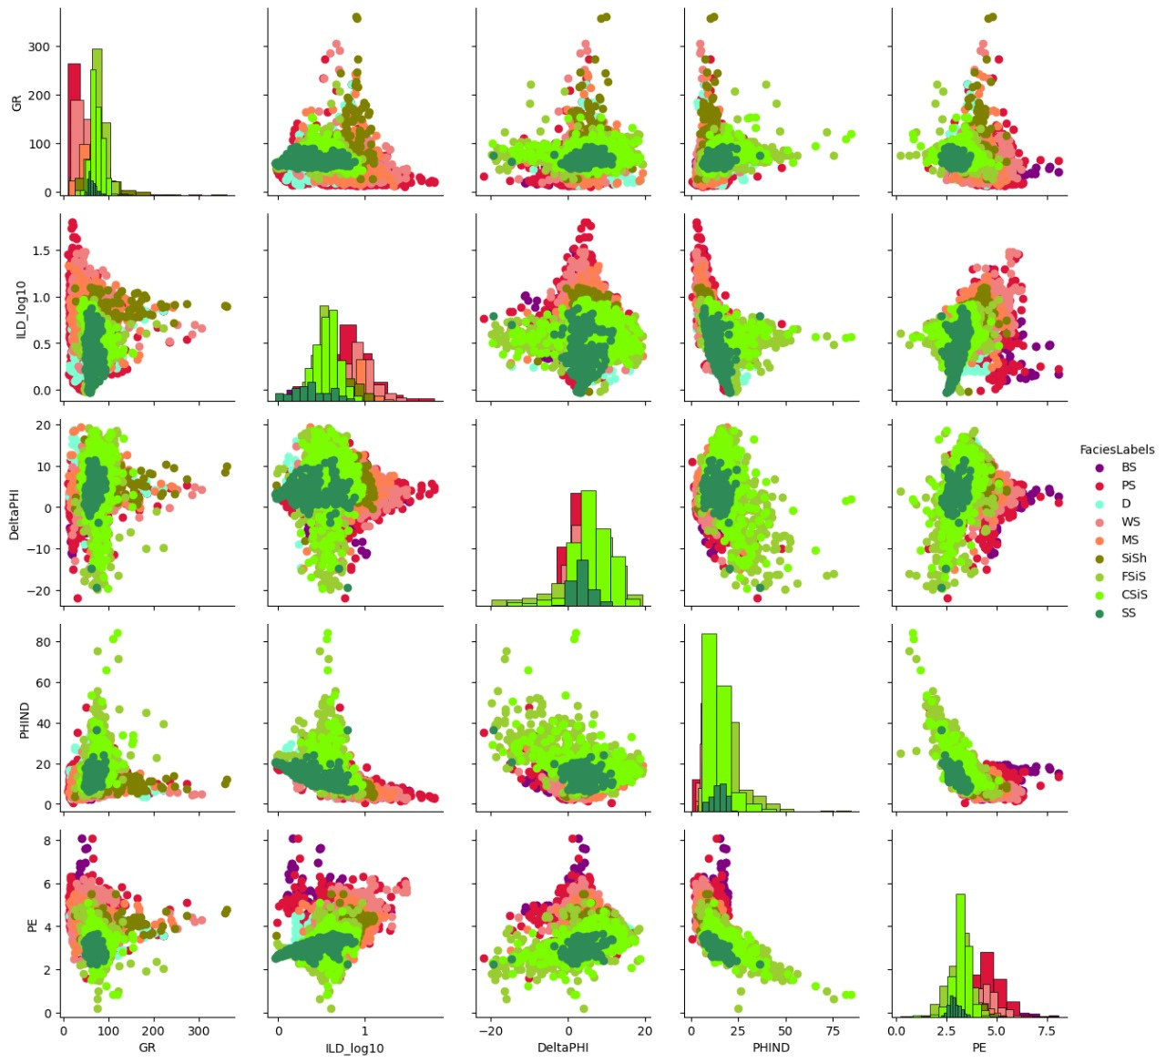
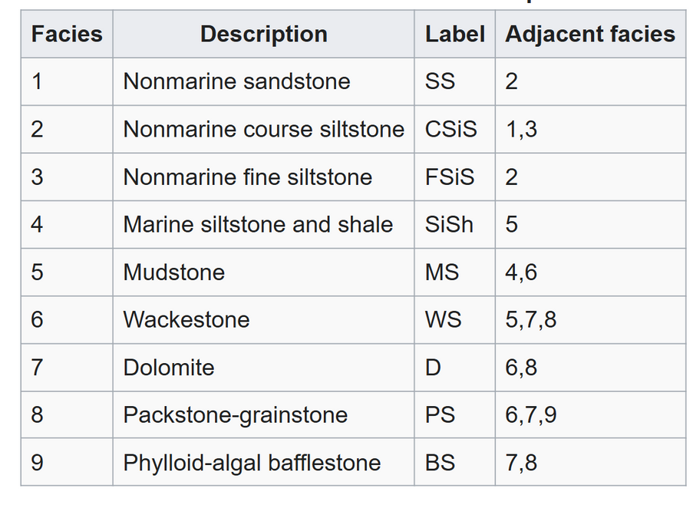
Quality Check
Facies labels with their descriptions:
Fig: Pair plots
4

Slide 5
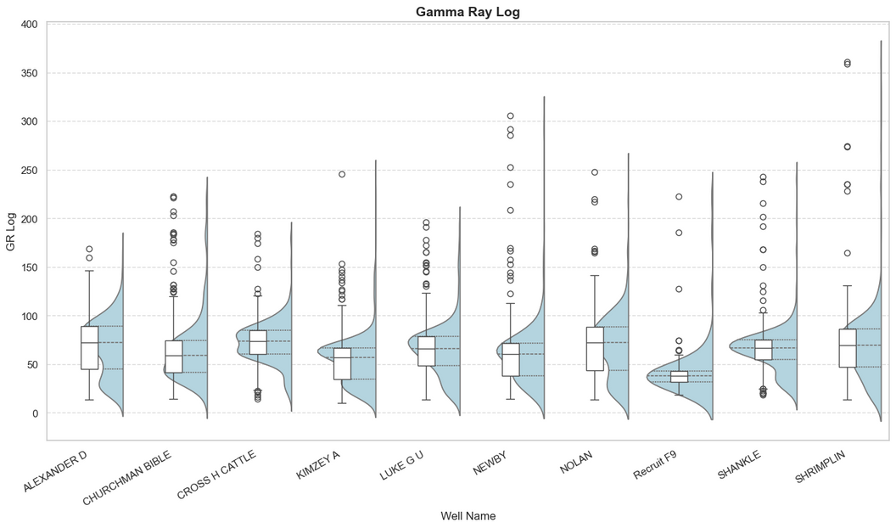
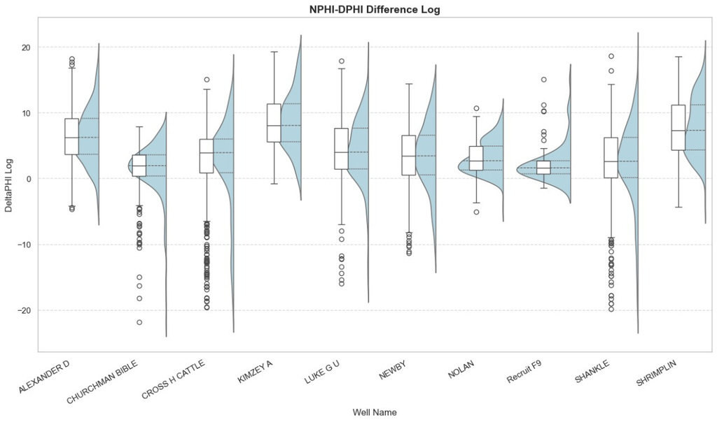
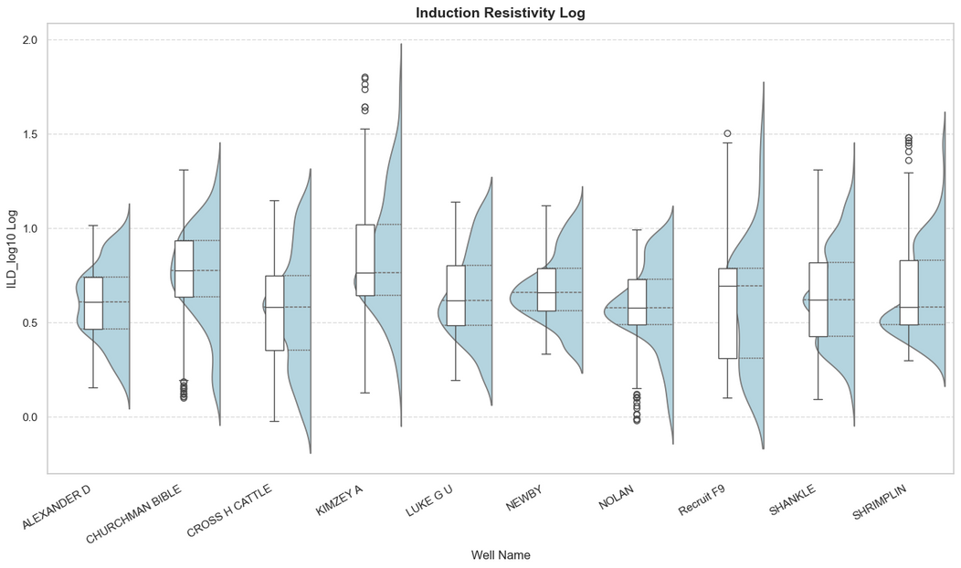
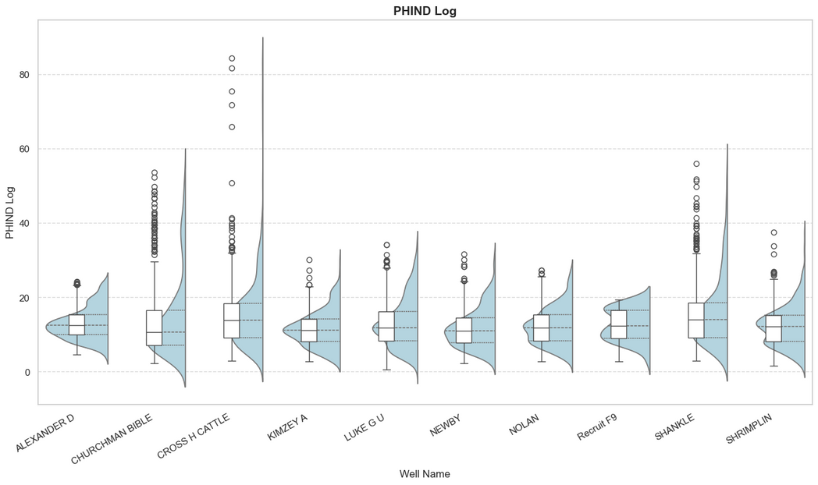
Outliers ?
Gamma Ray Log
NPHI-DPHI Difference Log
Induction Resistivity Log
PHIND Log
5
Fig: Half violin plot

Slide 6
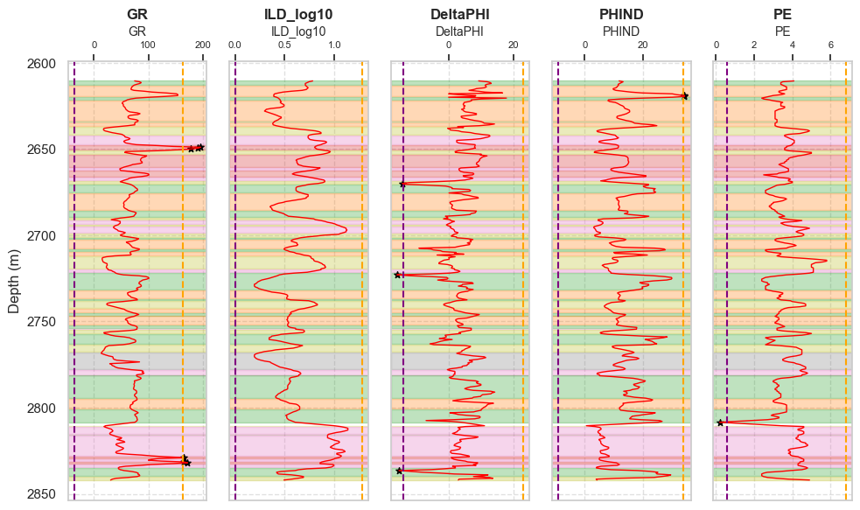
Outlier Identification
Well - LUKE G U
Whisker Length:
GR : 2.8
ILD_log10 : 1.5
DeltaPHI : 2.5
PHIND : 2.2
PE : 2.6
6
Fig: Basic logs

Slide 7
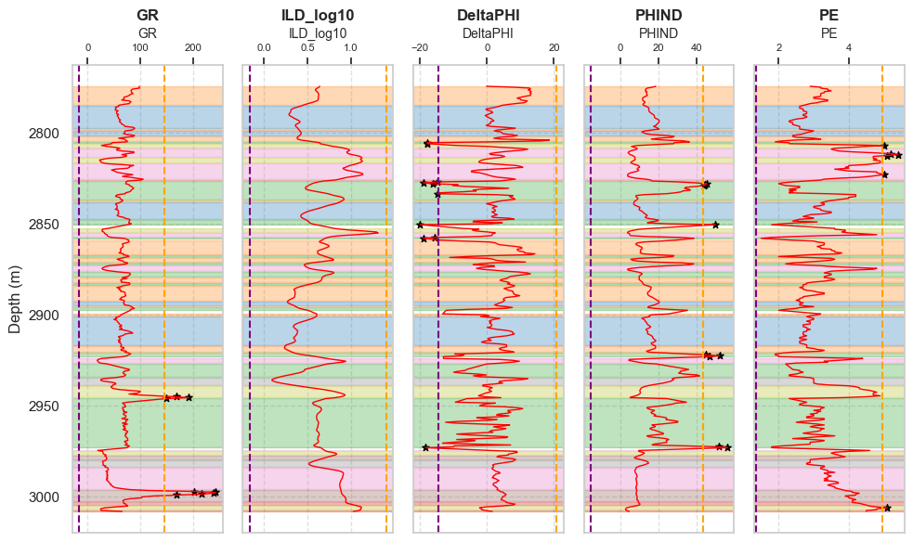
Outlier Identification
Well - SHANKLE
Whisker Length:
GR : 3.5
ILD_log10 : 1.5
DeltaPHI : 2.4
PHIND : 2.6
PE : 1.5
7
Fig: Basic logs

Slide 8
Predicting Missing PE log values
Predicting missing PE values is crucial for accurate lithology and facies classification, enabling reliable reservoir characterization across all wells.
Three wells without PE logs are ‘ALEXANDER D', 'KIMZEY A', and 'Recruit F9 '.
ML MODELS
INPUT DATA
DATA PREPARATION
DATA TRANSFORM
DATA PARTITION
RANDOM FOREST
MODEL SELECTION
GRADIENT BOOSTING
XG BOOST
WORKFLOW FOR PE LOG PREDICTION
8

Slide 9
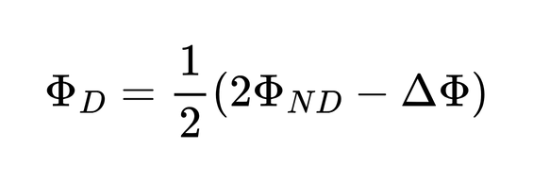
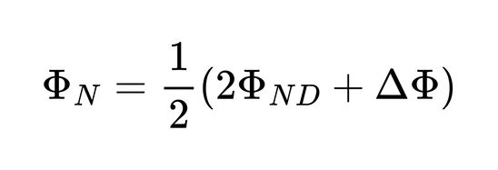
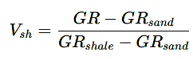
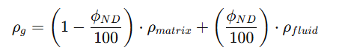
Feature engineering
New features like NPHI, PHID Volume of shale a,nd Bulk density are added to the use for the training
PHID (Density Porosity), derived using PHIND and DeltaPHI from the dataset.
NPHI(Neutron Porosity), derived using PHIND and DeltaPHI
Volume of shale
Bulk density
9

Slide 10
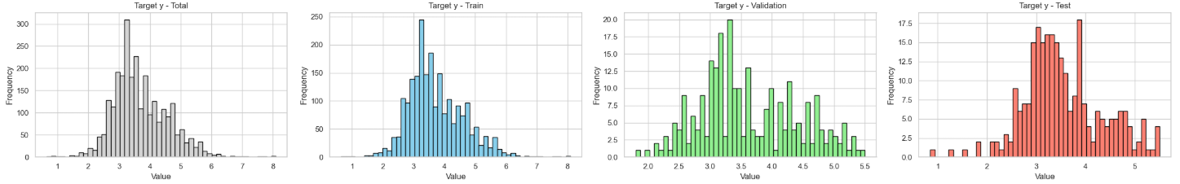
Data preparation and splitting
Total Training Data
High PE
PE>5.5
Training Set
80%
Input Data
6 wells
Validation Set
10%
Remaining Data
Model Training
Different Model Combination
Testing Set
10%
min(Training Score - Validation Score)
0.8 < Training Score < 0.9
Hyper Parameter Tuning
Best ML Model Selection
10
Fig: Histogram after data transform

Slide 11
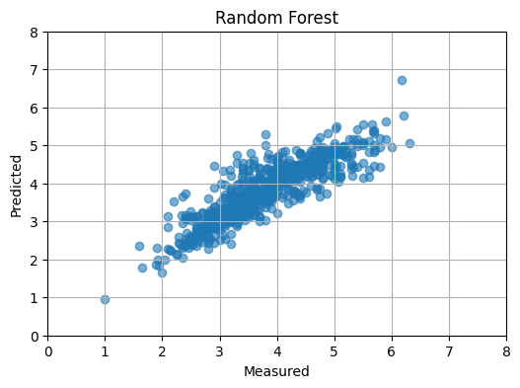
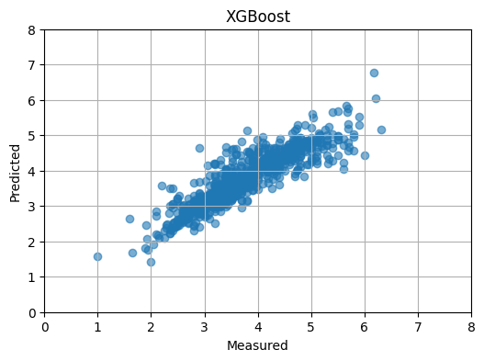
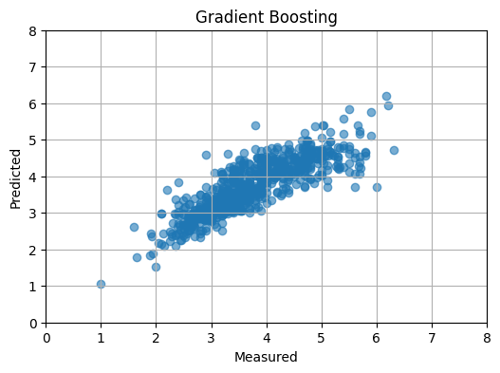
Regression models
RandomForest Regression
XGBoost Regression
Gradient Boosting Regressor
Random Forest Regressor Performance:
R2 Score: 0.78
MSE: 0.16
XGBoost Regressor Performance:
R2 Score: 0.79
MSE: 0.14
Gradient Boosting Regressor Performance:
R2 Score: 0.71
MSE: 0.20
11

Slide 12
Model accuracy
Model | R² Score | Mean Squared Error (MSE)
Gradient Boosting Regressor | 0.71 | 0.20
Random Forest Regressor | 0.78 | 0.16
XGBoost Regressor | 0.79 | 0.14
12

Slide 13
Blind test performance
Blind well - LUKE G U
Model | R² Score | RMSE | MAE
Random Forest Regressor | 0.68 | 0.40 | 0.30
Gradient Boosting Regressor | 0.65 | 0.42 | 0.31
XGBoost Regressor | 0.66 | 0.42 | 0.31
13

Slide 14
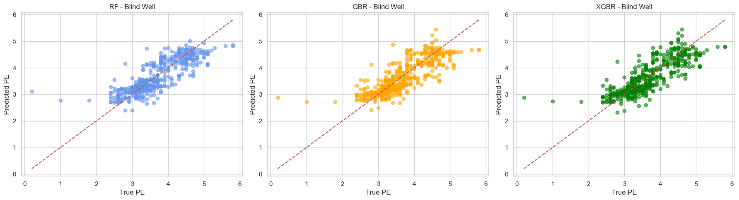
Blind test accuracy
Fig: Actual vs Prediction for different models
14

Slide 15
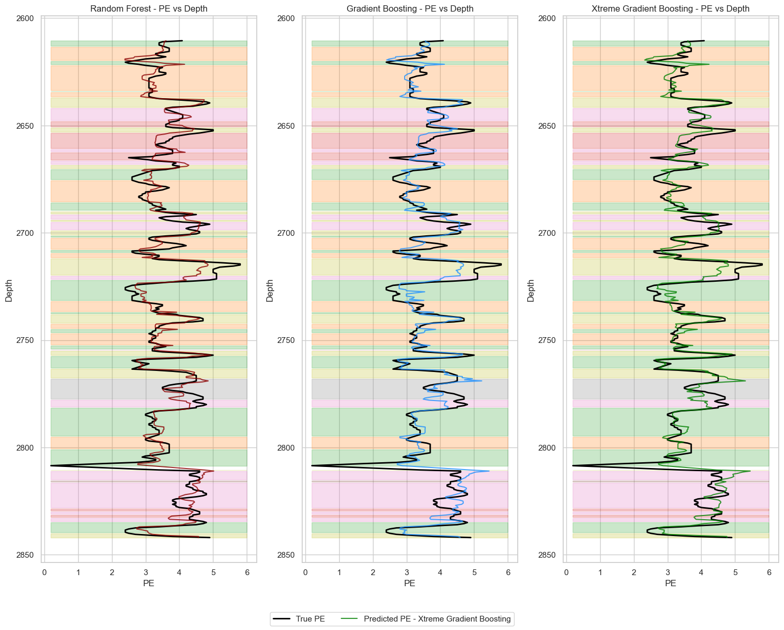
Blind test results
Random Forest performs best
Depth (m)
15
Fig: PE prediction in blind well - LUKE G U

Slide 16
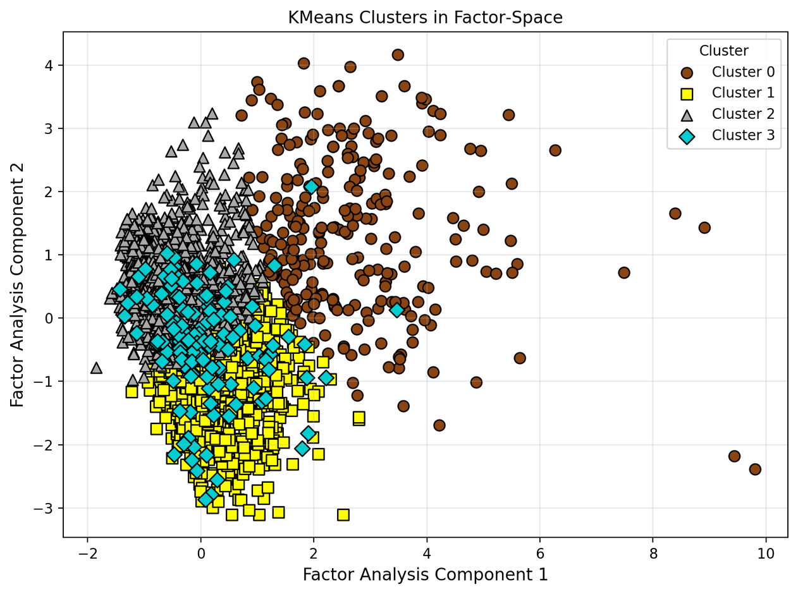
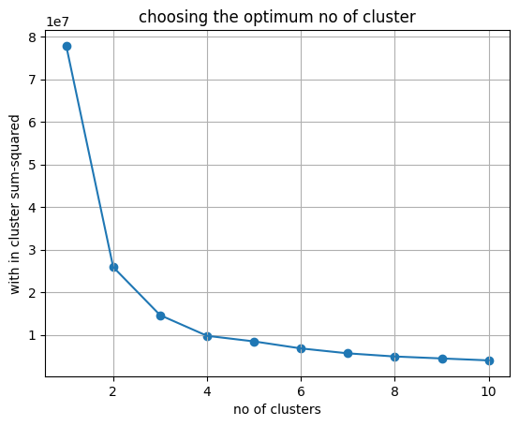
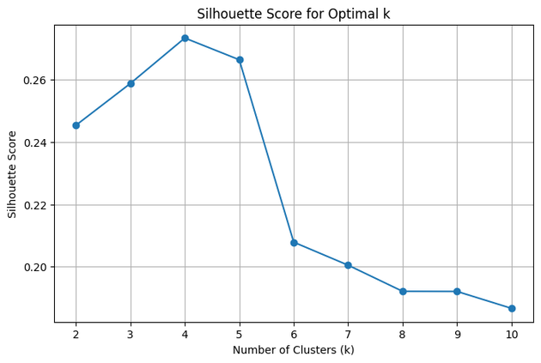
Unsupervised Technique
K means Clustering
Choosing Optimum number of clusters
Elbow method, Optimum n = 4 clusters
Fig: Elbow method
Silhoutte Score:
0.2734, for n = 4 clusters
Fig: K-means Clustering
16
Fig: Silhoutte method

Slide 17
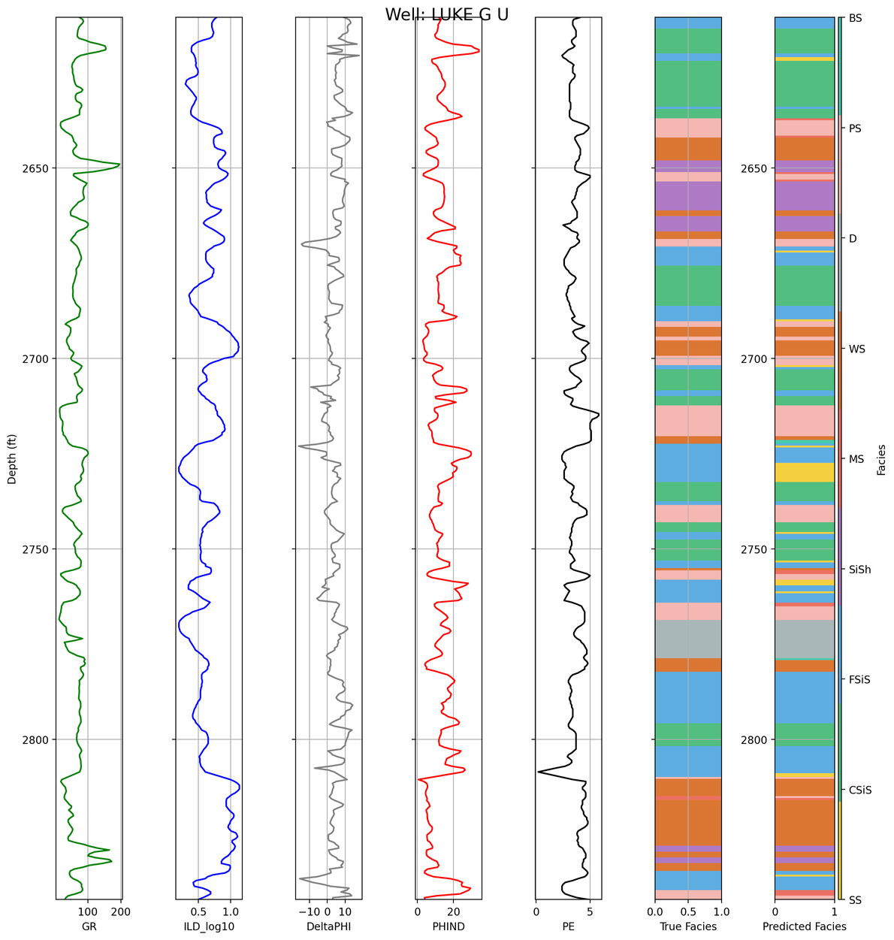
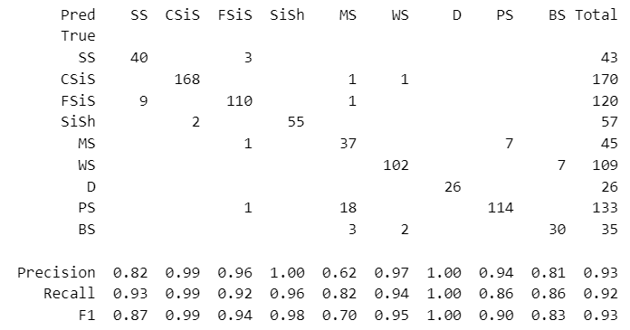
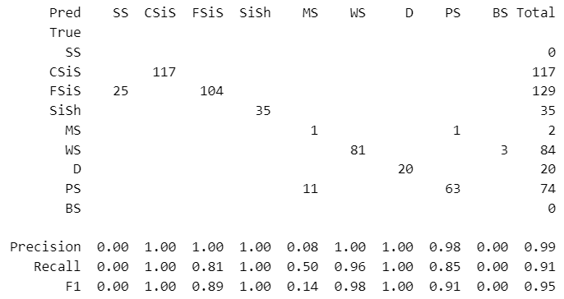
Supervised Techniques
Support Vector Machine (SVM) :
Confusion Matrix for Testing Dataset
Depth (m)
Confusion Matrix for Blind Dataset
Accuracy in the blind well – 0.91
GR
ILD_10
DeltaPHI
PHIND
PE
True
Predicted
17
Fig: SVM prediction in blind well

Slide 18
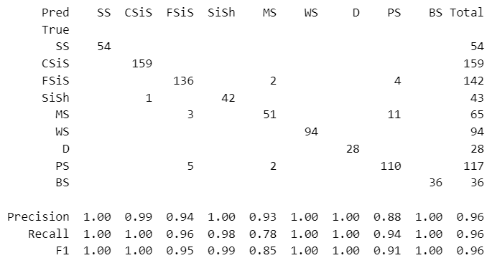
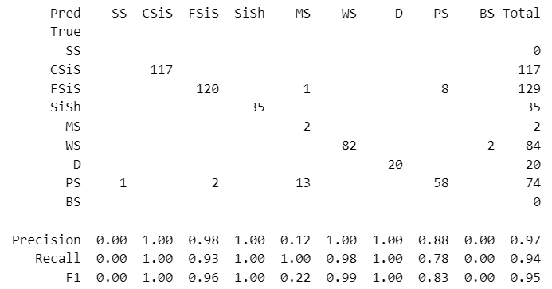
Supervised Techniques
Multi-layer Perceptron :
hidden_layer_sizes=(20,8,10)
max_iter=5000
alpha=0.0001
solver='sgd'
verbose=10
random_state=21
tol = 0.000000001
Confusion Matrix for Testing Dataset
Confusion Matrix for Blind Dataset
18

Slide 19
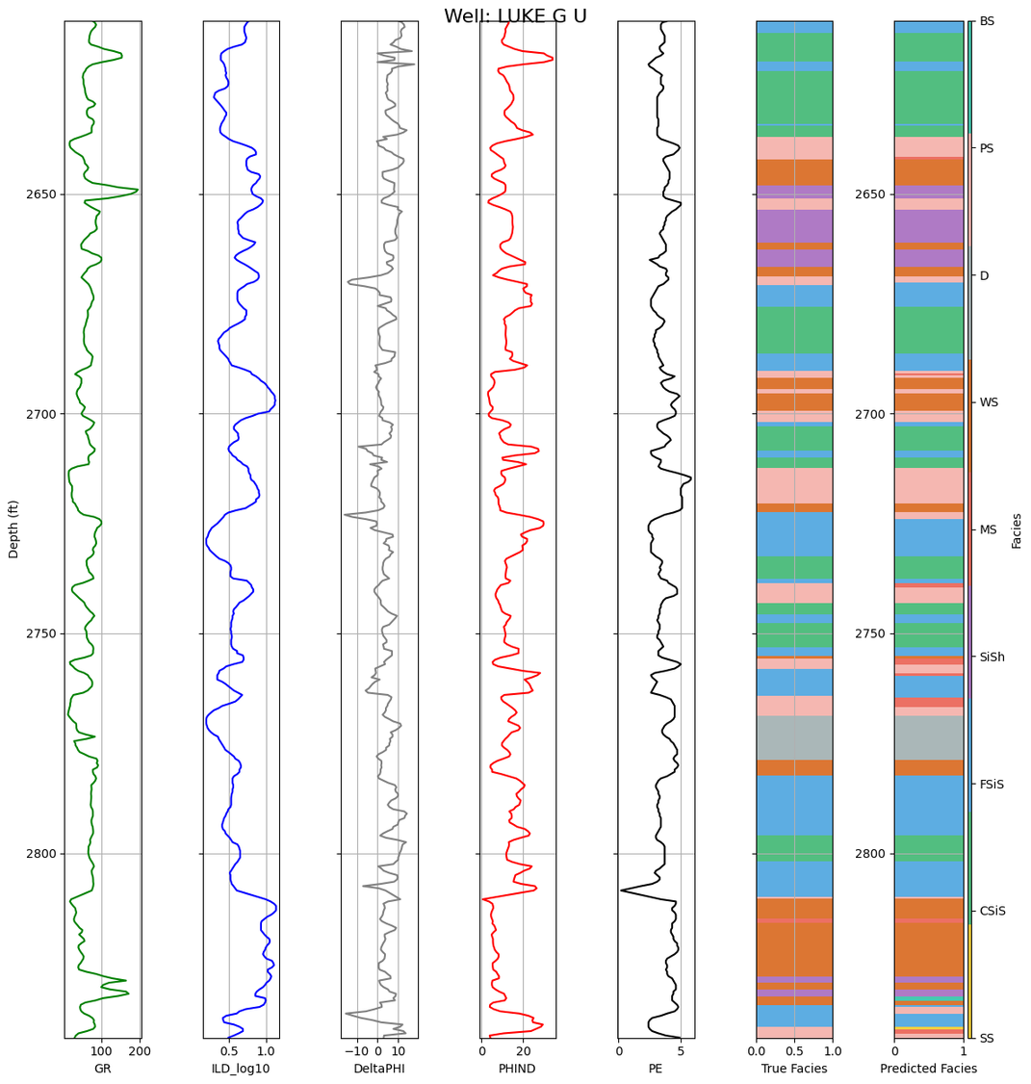
Supervised Techniques
Multi-layer Perceptron :
hidden_layer_sizes=(20,8,10)
max_iter=5000
alpha=0.0001
solver='sgd'
verbose=10
random_state=21
tol = 0.000000001
Depth (m)
Accuracy in the blind well – 0.94
GR
ILD_10
DeltaPHI
PHIND
PE
True
Predicted
19
Fig: MLP prediction in blind well

Slide 20
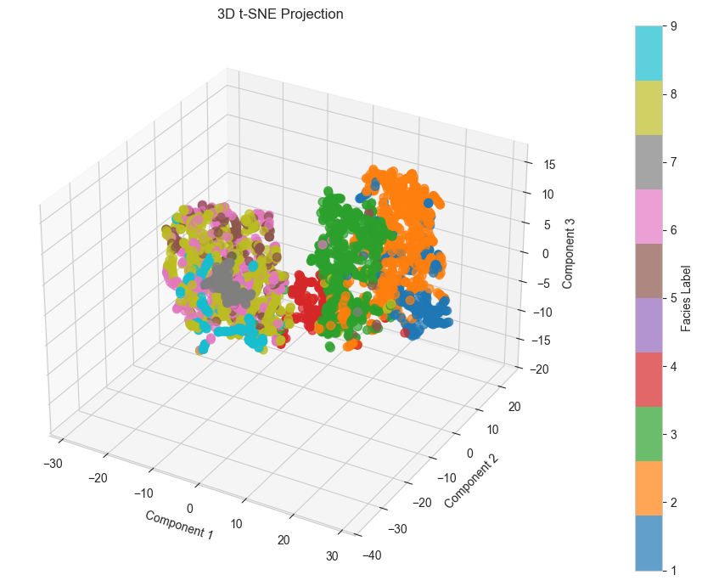
Supervised Techniques
t-SNE + KNN Method :
Features Used for Model Training : GR, ILD_10, DeltaPHI, PHIND, PE, NM_M, RELPOS, Vsh, NPHI, DPHI, Rho_ma, Rho_b
Dimensionality Reduction
12D Data
3D Data
Ref. Potratz1 et al., 2021
20
Fig: 3D t-SNE projection

Slide 21
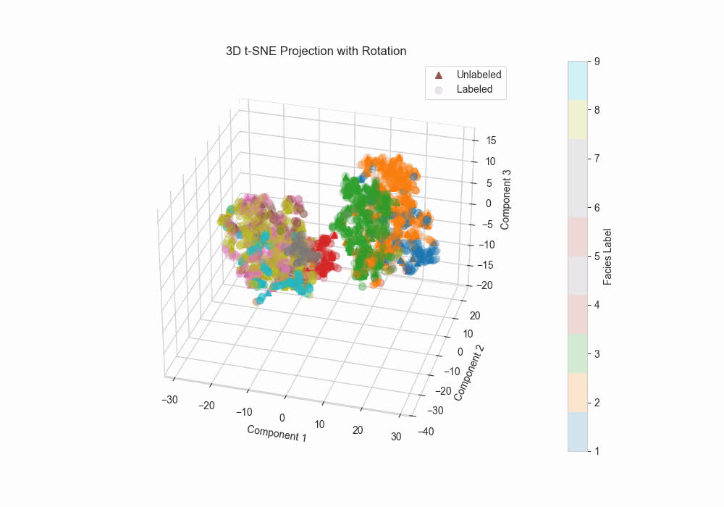
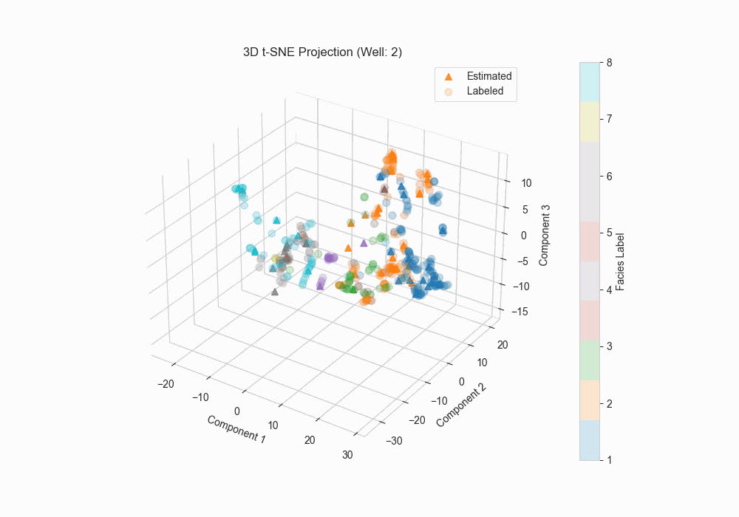
Supervised Techniques
K Nearest Neighbour: k = 5
Fig: 3D t-SNE projection
Ref. Potratz1 et al., 2021
21

Slide 22
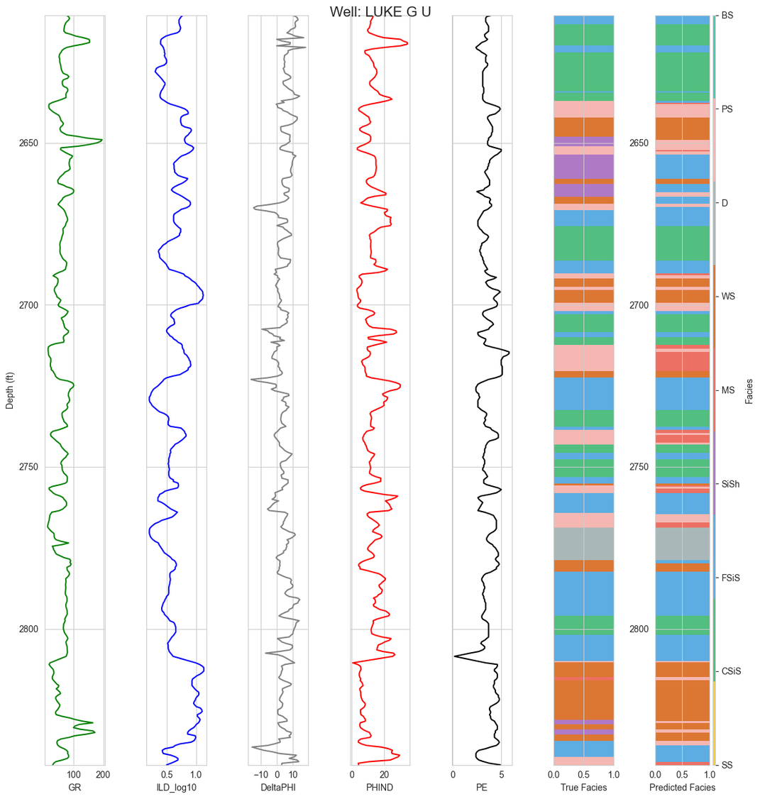
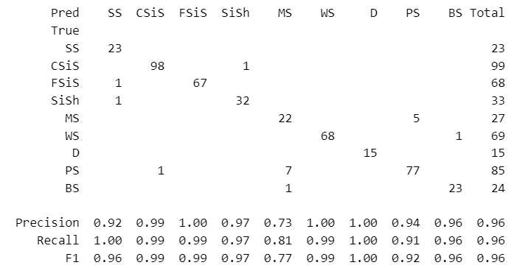
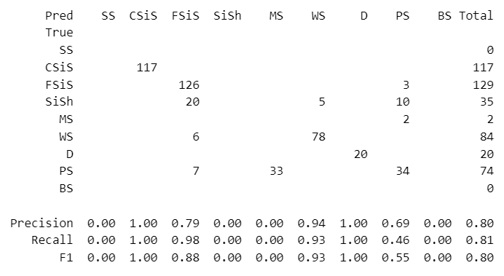
Supervised Techniques
Results :
Confusion Matrix for Testing Dataset
Depth (m)
Confusion Matrix for Blind Dataset
Accuracy in the blind well – 0.81
GR
ILD_10
DeltaPHI
PHIND
PE
True
Predicted
22
Fig: t-SNE prediction in blind well

Slide 23
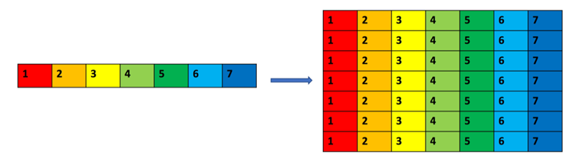
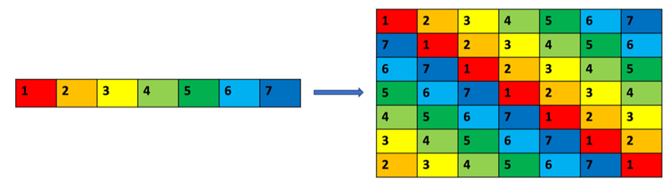
Supervised Techniques
Convolutional Neural Network :
Equal Padding :
Shift Padding :
Ref. Wei, Zhili, et al., 2019
23

Slide 24
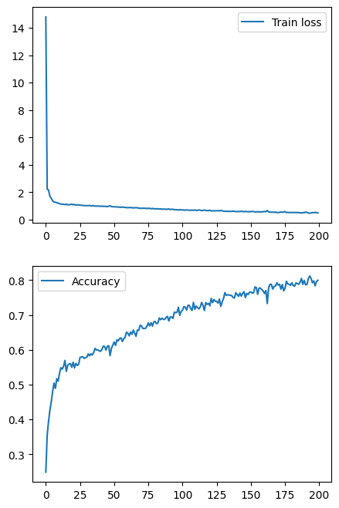
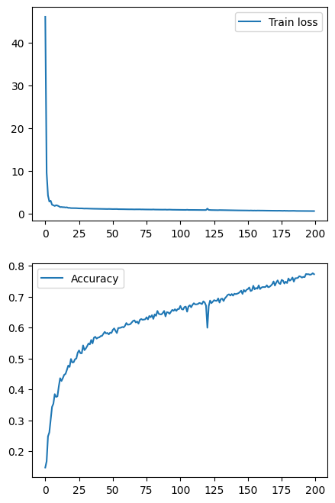
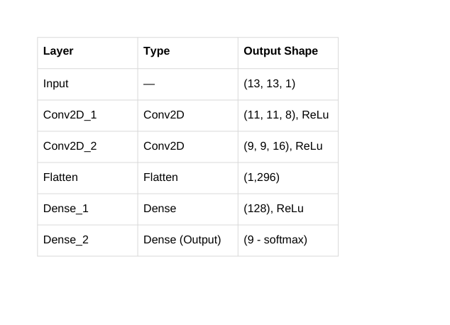
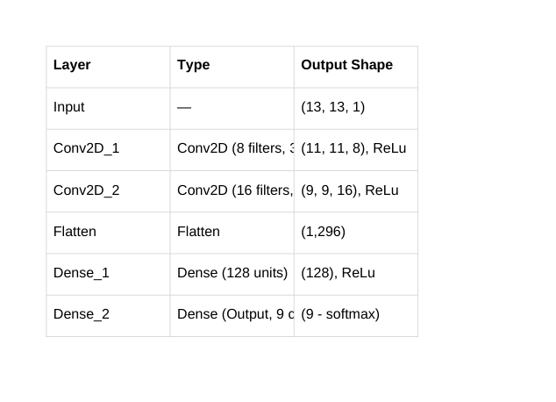
Supervised Techniques
Equal Padding :
Shift Padding :
Used Parameters:
Equal Padding :
Shift Padding :
Fig: Training loss and accuracy vs epoch
Ref. Wei, Zhili, et al., 2019
24

Slide 25
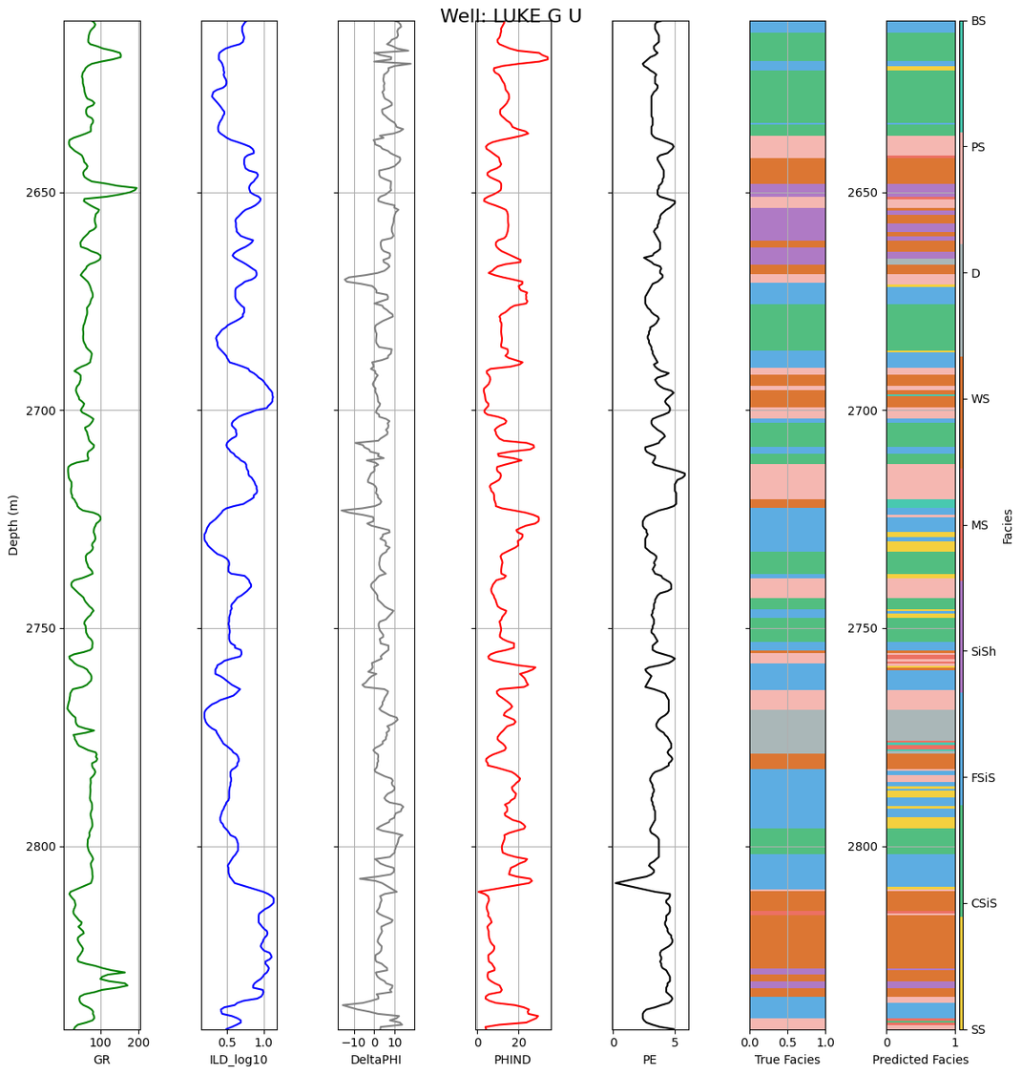
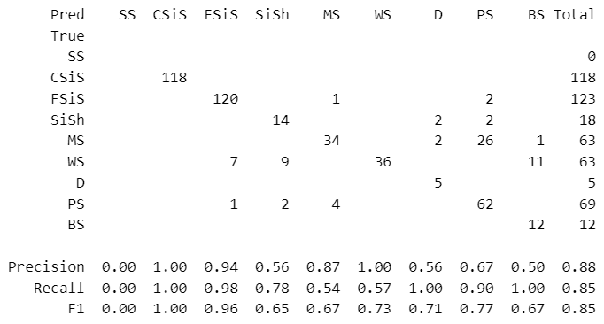
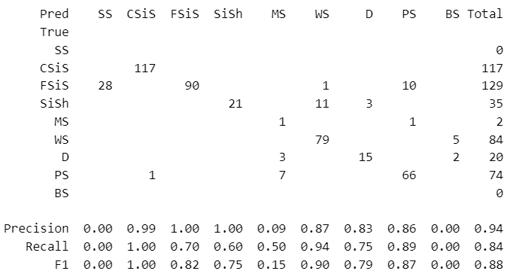
Supervised Techniques
Equal Padding Results:
Confusion Matrix for Testing Dataset
Depth (m)
Confusion Matrix for Blind Dataset
Accuracy in the blind well – 0.81
GR
ILD_10
DeltaPHI
PHIND
PE
True
Predicted
25
Fig: CNN prediction in blind well

Slide 26

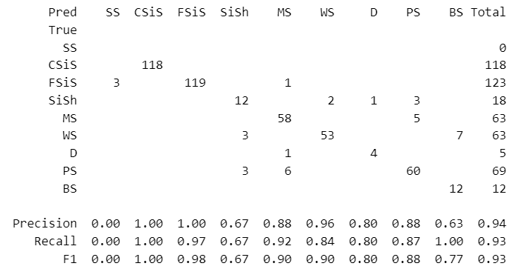
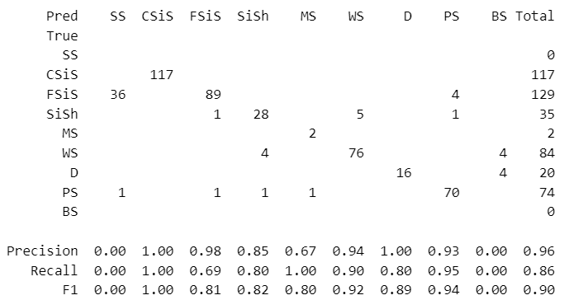
Supervised Techniques
Shift Padding Results:
Confusion Matrix for Testing Dataset
Depth (m)
Confusion Matrix for Blind Dataset
Accuracy in the blind well – 0.89
GR
ILD_10
DeltaPHI
PHIND
PE
True
Predicted
26
Fig: CNN prediction in blind well

Slide 27


Conclusions
Models | Precision | Recall | F1 Score | Accuracy
SVM | 0.99 | 0.91 | 0.95 | 0.91
MLP | 0.97 | 0.94 | 0.95 | 0.94
t-SNE + KNN | 0.80 | 0.81 | 0.80 | 0.81
CNN Shift | 0.94 | 0.89 | 0.91 | 0.89
CNN Equal | 0.94 | 0.82 | 0.86 | 0.81
Best Model
MLP performs the best classification in this case !
27

Slide 28
References
Wei, Zhili, et al. "Characterizing rock facies using machine learning algorithm based on a convolutional neural network and data padding strategy." Pure and Applied Geophysics 176.8 (2019): 3593-3605.
Potratz, G.L.; Canchumuni, S.W.A.; Castro, J.D.B.; Potratz, J. & Pacheco, M.C.C. 2021. Automatic Lithofacies Classification with t-SNE and K-Nearest Neighbors Algorithm. Anuário do Instituto de Geociências, 44: 35024. DOI 10.11137/2021_44_35024
www.people.ku.edu/~gbohling/EECS833/
https://github.com/weixiongdi/PyFacies
GPD510 Class Notes
Parham, K. D., and Campbell, J. A., 1993, PM-8. Wolfcampian shallow-shelf carbonate-Hugoton embayment, Kansas and Oklahoma; in, Atlas of Major Midcontinent Gas Reservoirs, D. G. Bebout, W. A. White, T. F. Hentz, and M. K. Grasmick, eds.: Bureau of Economic Geology, The University of Texas at Austin, Austin, Texas, 85 p.
Martin K. Dubois, Geoffrey C. Bohling, Swapan Chakrabarti,Comparison of four approaches to a rock facies classification problem,Computers & Geosciences,Volume 33, Issue 5,2007,Pages 599-617,ISSN 0098-3004,https://doi.org/10.1016/j.cageo.2006.08.011.
28

Slide 29

Thank You
for your kind attention
29

